Slide 1
SEMESTER 2 PROPOSALS

Slide 2
WHAT IS MERMAIDS?
The Mermaids Performing Arts Fund, part of the University of St Andrews Students Association, focuses on supporting performing arts in the community. It funds and manages various events, including productions, the Fresher's Drama Festival, and the Christmas Ball. Mermaids collaborates with eight affiliates, including the A Cappella Society, Blind Mirth, Comedy Society, Dance Club, Gilbert and Sullivan Society, Inklight Creative Writing Society, Musical Theatre Society, and The Revue Sketch Comedy. They also operate the Barron Theatre at the Byre for their shows.

Slide 3
THE PROPOSAL PROCESS
Before Submitting
Attend Office Hours
Submit Proposal
Proposal Form
Proposal Interview
Outcome
Budget Form
Risk Assessment
Wellbeing Plan
Deadline: 16/11/2023
5 Minute Interview on 19/11/2023
Contact Rights Companies if Applicable.
Find a Producer, Director and/or Publicist and Technician
Notes:
Proposals were launched yesterday.
You can now submit proposals to me from today.
Before you do this you must have seen a few members of committee during their office hours.
Proposals must include a proposal form, budget form, risk assessment and a wellbeing plan.
An invitation for the proposal interview on the 19th will be communicated with you.
The outcome will be sent late on the 19th or early on the 20st.

Slide 4
PROPOSAL FORM

Slide 5
Why This Show?
This section is there to understand the reasons for which you are intending to put on this show so that this can be considered when reviewing the proposal.
Forty Word Blurb
Briefly explain what the show is about. There are many online sources where inspiration can be taken from; however, it cannot be copied as it is not your intellectual property. It is very important that this paragraph does not give away too much about the show but does entice the people to attend the show.
Proposed Dates
30/01/2024 – 31/01/2024
18/02/2024 – 19/02/2024
20/02/2024 – 21/02/2024
24/02/2024 – 25/02/2024
03/03/2024 – 04/04/2024
11/03/2024 – 12/03/2024
01/04/2024 – 02/04/2024
Notes:
Things to consider in the Why this show section: Creative opportunities
Unique show opportunities for the Mermaids Performing Arts Fund
Development within your own theatre skills
what excites you about it?
Do you want to get other areas of the university or town involved?
How will it appeal/ relate to the student body?
What is the purpose and aim of this show?
What is the target age group?
What to consider in the proposed dates: Why are these performance dates the ones that suit your show best, is it because of the venue that you want to work in? Is it because of the complexity of the show and, therefore the determined time needed before the performance? Is it because this gives more time to focus on marketing an ensure that the show sells particularly well?

Slide 6
VENUES

Slide 7
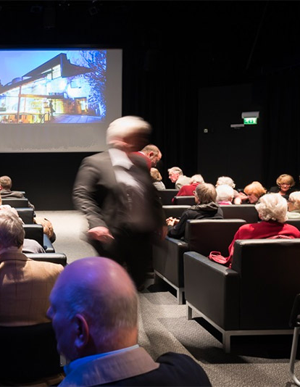
BARRON AT THE BYRE
Ticket Price: £5
Cost per Ticket: £1
Capacity: 60
Recommended Cast Size: Less Than 9
Possible Dates:
18/02/2024 – 19/02/2024
03/03/2024 – 04/03/2024
11/03/2024 – 12/03/2024
01/04/2024 – 02/04/2024

Slide 8
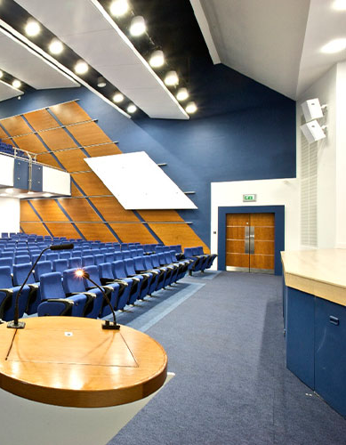
BUCHANAN LECTURE THEATRE
Ticket Price: £6
Flat Fee: £275
Capacity: 165
Recommended Cast Size: Less Than 14
Possible Dates:
24/02/2024 – 25/02/2024

Slide 9
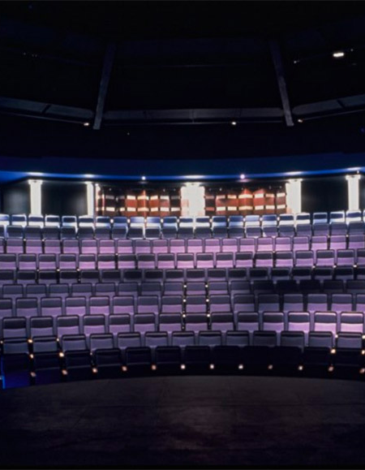
BYRE THEATRE
Ticket Price: £8
Flat Fee: £1050
Capacity: 216
Recommended Cast Size: Less Than 14
Possible Dates:
30/01/2024 – 31/01/2024
20/02/2024 – 21/02/2024

Slide 10
Why This Venue?
Is it because of the dates?
Cast Numbers
What is the range of cast members? You may have to take into account possible ensemble members, multi-rolling and gender-blind casting.
Is it because of the technical capabilities?
Is it because of the way that you feel it will enhance the show?
Approximate Run Time
From what you have seen of other productions of this play or if it is student-written, try and speak it at the pace you feel it should be performed for a few pages, and then from that, calculate the run time.
Notes:
Things to consider in the Why this show section: Creative opportunities
Unique show opportunities for the Mermaids Performing Arts Fund
Development within your own theatre skills
what excites you about it?
Do you want to get other areas of the university or town involved?
How will it appeal/ relate to the student body?
What is the purpose and aim of this show?
What is the target age group?
What to consider in the proposed dates: Why are these performance dates the ones that suit your show best, is it because of the venue that you want to work in? Is it because of the complexity of the show and, therefore the determined time needed before the performance? Is it because this gives more time to focus on marketing an ensure that the show sells particularly well?

Slide 11
RIGHTS
Please get in touch with the respective rights company that holds the performing rights of the show you are hoping to present and include this communication within this form. It is possible that there are no rights costs; however, it is still worth checking this rather than assuming.
The rights for most shows are overseen by:
Concord Theatricals (previously Samuel French Ltd)
Nick Hern
United Agents
Josef Weinberger Ltd.
Any plays written by a playwright who has been dead for more than 70 years don’t require rights agreements.

Slide 12
PRODUCTION TEAM
Director
Producer
Publicist
Lighting Technician
Sound Technician
Stage Manager
Costumer
Set Designer
Props Master
Notes:
The Director auditions and casts actors, provides design directives, leads rehearsals, and manage the production schedule of the project, ensuring that all the moving parts connect. Perhaps most importantly, they also supply a unifying understanding of the text and a particular vision for the production, which might mean a unique setting, a visual style or mood, or an exciting design concept that plays off themes in the text.
The Producer oversees all aspects of a theatre production, from the generation of an idea to the day-to-day management when it is on stage. They assemble and oversee the production team. They are the person responsible for the financial, strategic and managerial aspects of staging the production.
The Publicist promotes the production. They run any social media for the production, organising in-person promotion, flyering, and press coverage.
The Lighting Designer manages the lighting for the play. They create the atmosphere whether creating an inviting mood with a single bulb, building a plot that expertly evokes a specific place or time of day, or directing the glow of hundreds of floods and spots to illuminate an outdoor stage, lighting designers marshal the transformative power of light to illuminate performers, focus an audience's eyes, support a narrative, and trigger emotions.
The Sound Designer collects, edits, and creates sound effects, ambient effects, and even music. They are responsible for creating or compiling high-quality audio assets for the play. The audio assets that they are responsible for include sound effects, background score, and voice-over.
The Stage Manager facilitates communication across all creative and technical departments; acts as a right hand to the director and producer; oversees sets, props, lights, and sound during performances.
The Costume and Make-Up designer tells a story through clothing and make-up, using the language of fashion to help express aspects of a play or opera's setting, mood, and characters. Their job is about much more than putting together a nice outfit or attractive face, requiring a deep understanding of stage production, a thorough knowledge of fashion and costuming history, and an eye for creating standout visual designs. With each wardrobe element and accessory, costume designers bring the characters and settings to life, and immerse audiences—and actors—in their time period, culture, and world.
The Set Designer is responsible for the worlds that characters on the stage and screen inhabit: from the rooms, buildings, and outdoor spaces they move through to the pieces of furniture that fill them, and even aspects of presentation like the set's angle. All of it tells a story to the audience, and it's the job of the set designer to ensure that the director's vision comes across in the visual language of scenic design.
The Props Master on a production is the head of the props department. The prop master, short for property master, is responsible for acquiring appropriate props, organizing them, and overseeing the usage of props on set.

Slide 13
GENERAL VISION

Slide 14
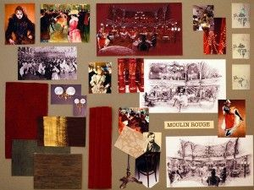
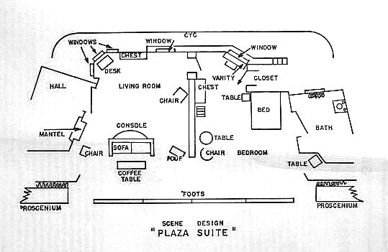
SET
Ideas for showing Set ideas:
Mood Board
Stage Plot
Set List
Office Hours:
The Set and Props Officer Bella Hirst – (merprops@...) Wednesday, 11 am – 12 pm at the Byre Theatre

Slide 15
PROPS
Ideas for showing Prop ideas:
Mood Board
Props List
Office Hours:
The Set and Props Officer Bella Hirst – (merprops@...) Wednesday, 11 am – 12 pm at the Byre Theatre

Slide 16
COSTUMES
Ideas for showing Set ideas:
Mood Board
Sketches
Costumes List
Office Hours:
The Costumes Officer Gretchen Mills – (gm308@...) Wednesday, 12 pm – 1 pm at the Old Burgh School

Slide 17
LIGHTING
To explain your exact ideas for your lighting you could consider the following:
Lighting States
Style
Colours and Characters
Setting
Transitions
Office Hours:
The Tech and Ops Officer Heather Tiernan – (ht47@...) Wednesday, 1 pm – 2 pm in Rectors

Slide 18
SOUND
To explain your exact ideas for your sound you could consider the following:
Sound List
Example Sound Effects
Office Hours:
The Tech and Ops Officer Heather Tiernan – (ht47@...) Wednesday, 1 pm – 2 pm in Rectors

Slide 19
MARKETING
To explain your exact ideas for your marketing, you could consider the following:
Draft Poster Graphic
Social Media Ideas
Non-Social Media Marketing Plans
For advice: Contact the Marketing Officer
Amalia Villegas – (av92@...)

Slide 20
OUTREACH
Please detail any ideas to collaborate with other societies, subcommittees or charities. This could include joint events such as socials or discussions, awareness talks, common publicity or including them in the programme.
Office Hours:
Engagements Officer Eleanor Whorms – (ew239@...) Tuesday, 10 am – 11 am at the Byre Theatre

Slide 21
BUDGET FORM

Slide 22
INCOME
Notes:
The most important parts of this section are calculated for you in the budget sheet. If you are requesting/have been granted money from places other than Mermaids, then write how much here. This should also be detailed in the relevant section of the proposal form.

Slide 23
TICKET SALES
Notes:
How you fill in this section will depend on the venue you are proposing for. Normally, shows will have two performances regardless of venue. Ticket prices and Venue capacity are given in the venue breakdowns. If you are using an alternate venue, please do relevant research on capacity, and if you wish to use the Barron or the Stage without the seating rack (e.g. in the round), be realistic about the number of chairs that can be fit in and talk to relevant people about what this capacity might be.

Slide 24
EXPENDITURE
Notes:
The total for venue hire is filled in automatically. Rights should be filled in across all nights of performance plus VAT – if the rights company says the cost of the show is £75 per night and you are planning on two performances, the total cost of rights to be filled in here would be £180 (2x75 + 20% VAT). For every other section, please fill the boxes in as accurately as you can – it is a good idea to list what you plan to spend the money on in the description boxes on the right and note how much each item will cost (you can even include links to the items you might buy that you have found online and the websites you plan on buying from). Please detail what the money will be spent on for every section – even publicity (the ‘recommended £15’ is misleading - we would still like to know how you plan on spending this).
Ticket production does not need to be filled in for any of the three main venues we use, and please fill the ‘Other’ box with a 10% contingency of your overall budget.

Slide 25
BREAK EVEN
Notes:
This box is calculated automatically using the numbers you put in, and you should keep an eye on it while you are working on your budget. We aim for a break-even of around 66% - being well under this is fine, but maybe check through your budget to ensure you’ve filled it in correctly and are happy with how much money you are proposing to spend and where. Please ensure that you don’t go too much over 66%, though – this will make your show harder for us to pass.

Slide 26
RISK ASSESSMENT
Notes:
A risk assessment is not as scary as it sounds. The term is used to describe the overall process or method where you: Identify hazards and risk factors that have the potential to cause harm (hazard identification). Analyse and evaluate the risk associated with that hazard (risk analysis, and risk evaluation). Determine appropriate ways to eliminate the hazard, or control the risk when the hazard cannot be eliminated (risk control). Risk assessments are used to ensure everyone remains healthy and safe in accordance with The Health and Safety at Work etc Act 1974 and other associated laws and legislations.

Slide 27
THINGS TO ASSESS FOR
Things to risk assess for:
Control of Substances Hazardous to Health (COSHH)
First Aid provision
Provision and use of equipment Manual Handling
Noise
Fire Risk & Evacuation procedures
Control of Asbestos
Security (eg, trespass, theft etc)
Lone Working
Working at Height
Prevention of slips, trips and falls
Erection and breakdown of sets and other stage equipment
Common Show Risks
Manual Handling
Working in low areas of light
Temporary storage of set
Building set
Cable routing
Show Specific Risks
Use of weapons
Hazer
Strobe
Food/drink
Stage Blood
Glass
Standing on furniture
Lifting a performer
Fight scenes

Slide 28
Activity | Hazard List hazards here | Who might be Harmed list persons | Initial Risk Rating S x L | Control Measures What are you doing to mitigate against the risk | Risk Rating S x L | Further Action Required

Slide 29
WELLBEING PLAN

Slide 30
WELLBEING PLAN
Wellbeing Coordinator (as designated member of production team for wellbeing concerns)
Please list the relevant trigger warnings for your show:
Please locate and list at least one (1) resource for each trigger warning that will be accessible to your cast and crew:
Please list additional measures you will take to ensure cast and crew wellbeing throughout the production:
Notes:
Wellbeing is essential to all productions as a cast and production team that feels well and supported will be able to enjoy the experience and perform their best. Being involved in a production can create some wellbeing challenges: long rehearsals, emotionally charged scenes, and an extra addition of work onto already busy student lives. With these factors in mind, Mermaids has collated some key resources and recommendations on how to maintain wellbeing and support your cast and crew during the production, and we ask that you read this guide and then complete the wellbeing plan on the following page.
Recommendations
At your first rehearsal, take the time to build community and set boundaries. Have everyone introduce themselves, some basic information (degree, year, etc.), and their pronouns if they would like. Also explain what is in place to ensure wellbeing throughout the show. This might include:
Introducing a designated member of the production team who will serve as the Wellbeing Coordinator and ensuring an alternate is also introduced in case there is a conflict of interest with the coordinator.
Explaining that cast members are free to take a breather if they need to at any point in rehearsal. You may also choose to ask that if they need anything more than a quick reset, or if they need to step out for the remainder of the rehearsal (or more), that they message the director or Coordinator.
Discussing how you will begin and end each rehearsal. Consider whether you might begin each rehearsal with a 5-minute chat period, a quick character exercise, or a stretch. Similarly, how will you signify each rehearsal is over and that you are all leaving the rehearsal mindset. This helps to separate actors and crew from their show roles and their real lives.
Decide on ‘working hours’: the times where cast and crew can exchange information and messages and expect a response; Outside of these hours, responses cannot be expected.
Offer trigger warnings for each rehearsal as possible. Ideally, provide these in your rehearsal schedule so that participants can prepare themselves.
Ensure that more intimate/challenging scenes are done incrementally. Schedule a rehearsal that is just the relevant actors and the director. Then introduce the scene at a run through that is more relaxed.
Especially for physical interactions, do them enough that they are comfortable but do not repeat them unnecessarily to ensure people are not overwhelmed.
Make the rehearsal process interactive. Ask for feedback throughout rehearsals and offer opportunities for dialogue about why things are being done a certain way.
As you get closer to show dates, make sure you are reviewing the parts of the show actors are not yet comfortable with.

Slide 31
OFFICE HOURS
As part of your proposal, you are required to have met with either:
The Mermaids President Marisa Singh – (merpres@...) Tuesday, 11 am – 12 pm at the Byre
The Vice-President Taylor Colbeth – (tnc1@...) Tuesday, 12 pm – 1 pm at Main Bar
The Productions Coordinator Jacob Carey (me) – (merprodcoordinator@...) Monday, 5 pm – 6 pm in Soc Room C If you are proposing for the Barron, you must also go to the office hours of:
The Barron Manager Alice Banks – (barronlib@...) Monday, 10 am – 11 am at the Byre

Slide 32
PROPOSAL INTERVIEW
Once the committee has received your proposal you will then be given a 5-minute time slot for the interview itself.
Who is there? All committee members, so 16 in total.
The Producer, Director and either publicist or technician, but if you want to bring anyone else, you can.
In the meeting, you will be given 2 minutes to describe your general ideas and elaborate on all parts of the proposal
The committee will then have 3 minutes to ask you any questions regarding your proposal
The committee will then discuss the proposals, and I will send outcomes either very late on the 19th or exceptionally early on the 20th.

Slide 33
FINAL NOTES
Mermaids is a funding body and not a society, we can’t pass shows based on creative merit. We judge proposals based on the following:
Financial
Logistical
Skills-based merit
You don’t have to be able to answer all of these questions, but it’s definitely something to think about with regards to how likely we are to pass your show!
Notes:
Logistical: consider the feasibility of your show – do we have the resources, time, and ability to put it on? Will you have access to enough potential actors and will they be able to safely fit and work in your proposed venue? Do we have access to the equipment you require? Are you able to (within reason) guarantee the health and safety of everyone in your cast and crew?
Skills-Based:
Mermaids is dedicated to providing opportunities for students, so how many new people are on your production team? Are you planning on taking on any assistants or shadows for your team? Are you wanting to work with other student societies, local businesses, or academic departments? What is the gender split of your cast?

Slide 34
ANY QUESTIONS?

